Slide 1
ATMOSPHERIC MODELING:
INTRODUCTION, SOME APPLICATIONS AND COMPUTATIONAL DEMANDS
Aules d’Empresa 2013
Oriol Jorba and Kim Serradell
Barcelona, 25 January 2013

Slide 2
Outline
Brief overview of BSC and the Earth Sciences Department
Introduction to Atmospheric Modeling
  The Earth System
    Global to regional processes
    From short-term to climate
  Impacts of Atmospheric Processes
    From short-term to climate scales
  Numerical models
    NWP
    Air quality
  Model results examples

Slide 3
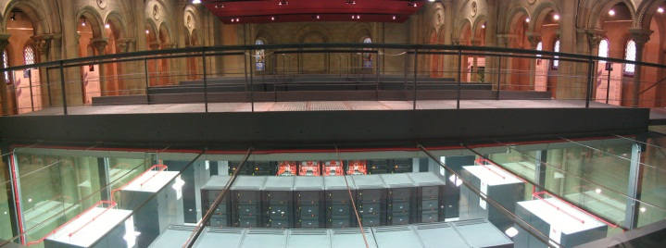



BSC-CNS
Barcelona Supercomputing Center – Centro Nacional de Supercomputación (BSC-CNS) is the Spanish National Laboratory in supercomputing.
The BSC mission:
  To investigate, develop and manage technology to facilitate the advancement of science.
The BSC objectives:
  To perform R&D in Computer Sciences and e-Sciences
  To provide Supercomputing support to external research.
BSC is a consortium that includes:
  the Spanish Government – 51%
  the Catalan Government – 37%
  the Technical University of Catalonia – 12%
Notes:
3

Slide 4
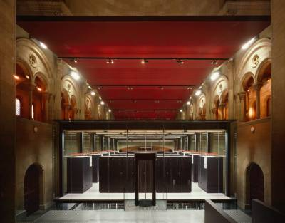
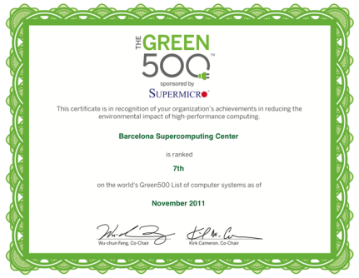
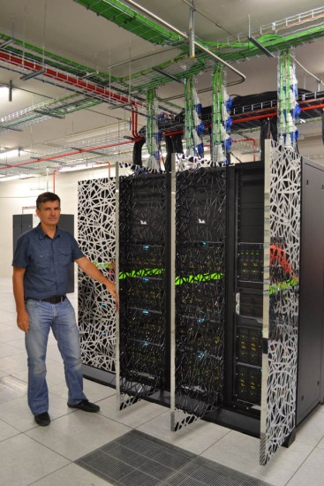
BSC Current Resources
MareNostrum ₂₀₁₃
  48448 Intel SandyBridge-EP cores
  1 PFlops
MinoTauro 2011
  128 compute nodes
  182 TFlops
HPC Storage and Backup:
  2.5 PB disk
  6.0 PB tapes Robot
Notes:
4
4

Slide 5

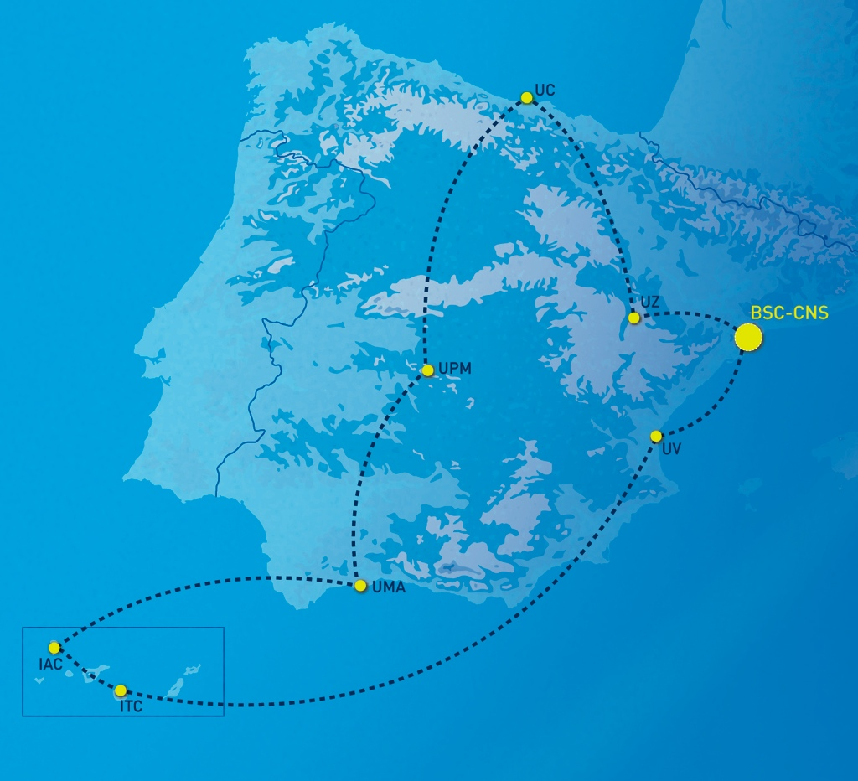
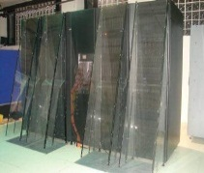

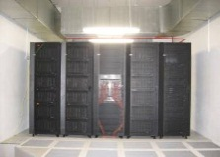
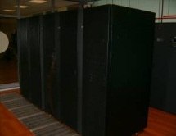
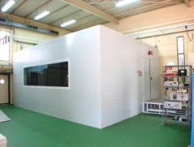
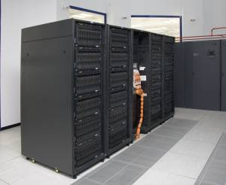
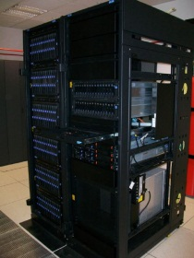
BSC in Spain
Altamira
Universidad de
Cantabria
MareNostrum
BSC
CaesarAugusta
Universidad de
Zaragoza
Magerit
Universidad Politécnica Madrid
Picasso
Universidad de
Málaga
Tirant
Universidad de Valencia
La Palma
IAC
Atlante
ITC
Notes:
5

Slide 6
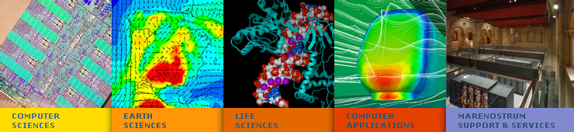
BSC Scientific & Technical Departments
www.bsc.es
6
Notes:
6
6

Slide 7
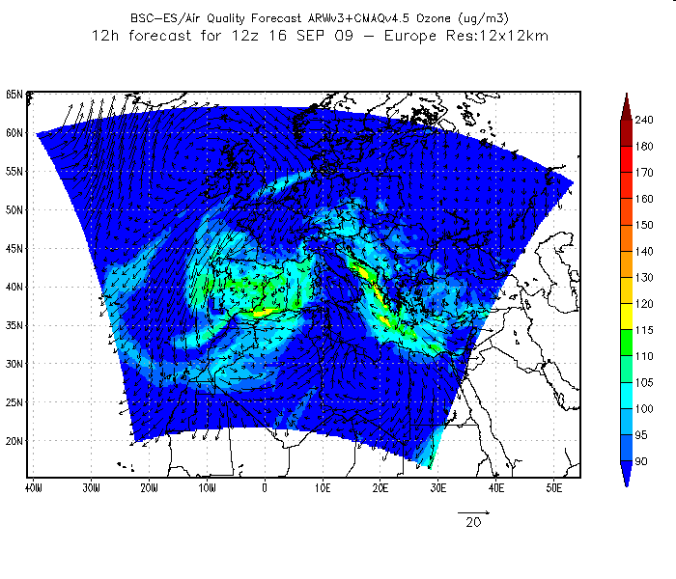
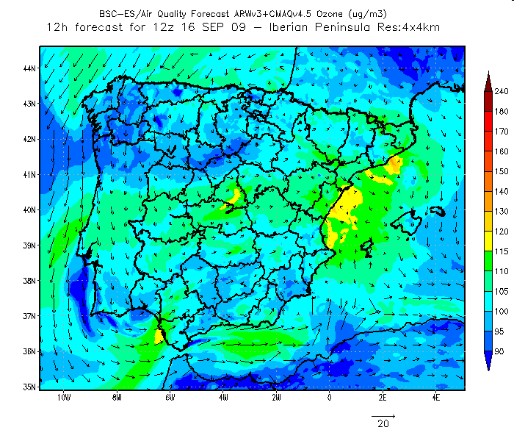
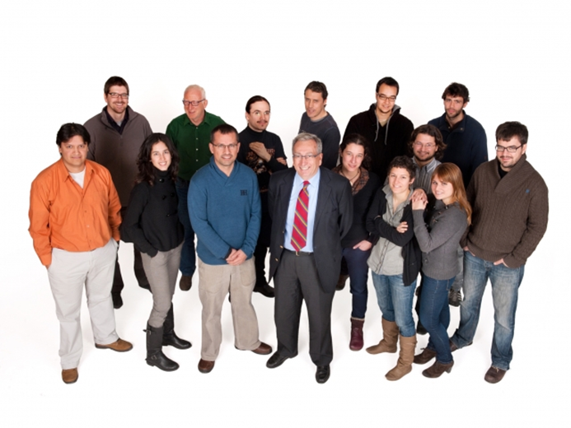
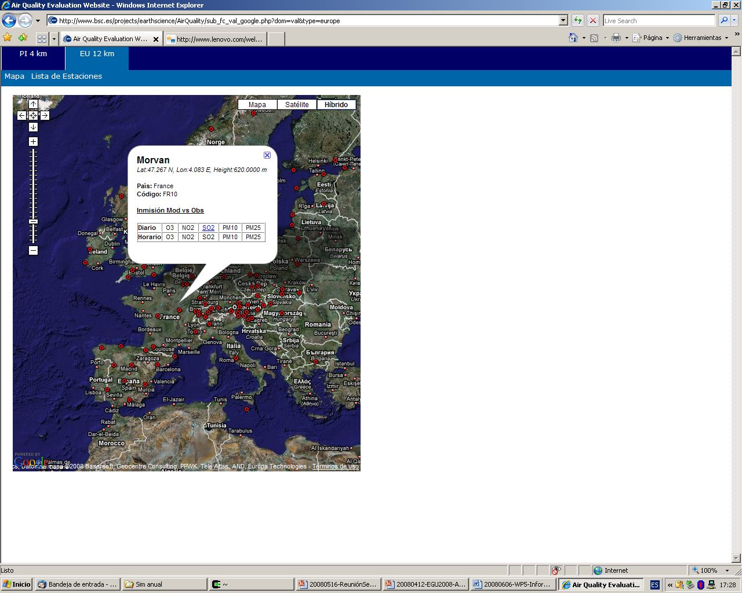
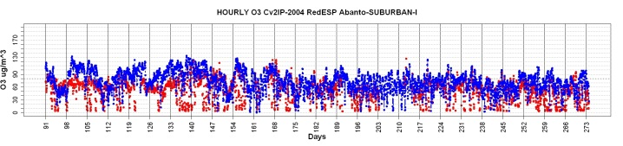
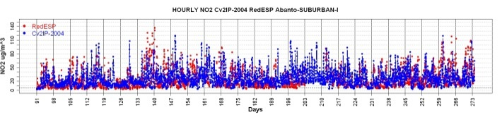
Earth Sciences Department (www.bsc.es/earth-sciences)
Research in the Earth Sciences area is devoted to the development and implementation of regional and global state-of-the-art models for short-term air quality forecast and long-term climate applications.
ES maintains two daily operational systems: AQF CALIOPE and MD forecasts: BSC-DREAM8b and NMMB/BSC-CTM.

Slide 8
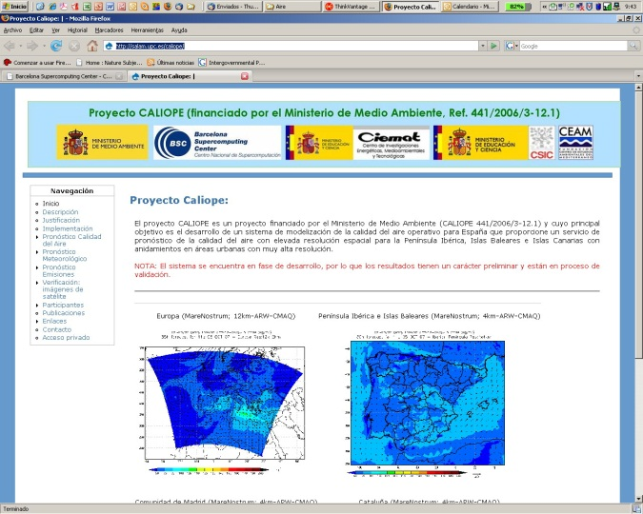
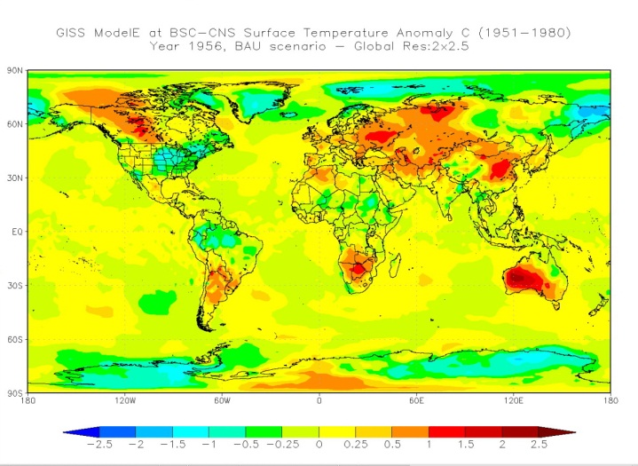
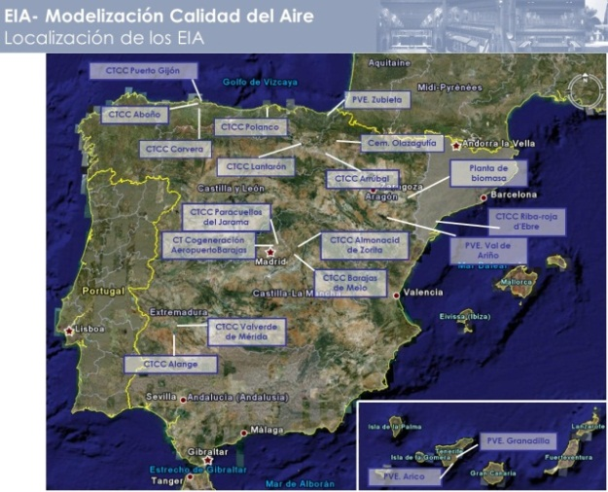
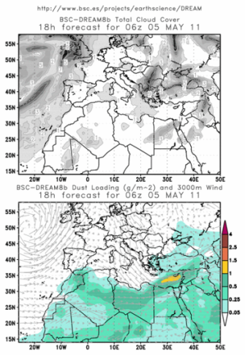
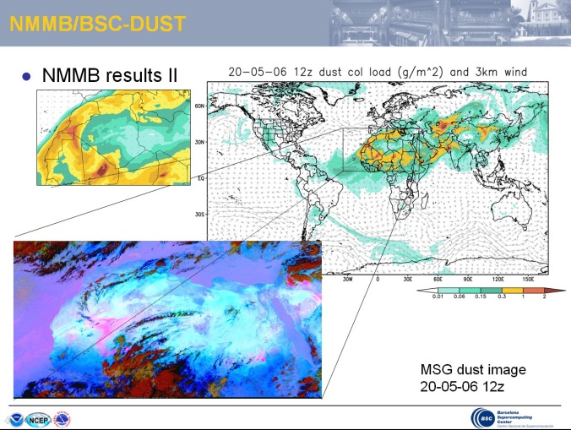
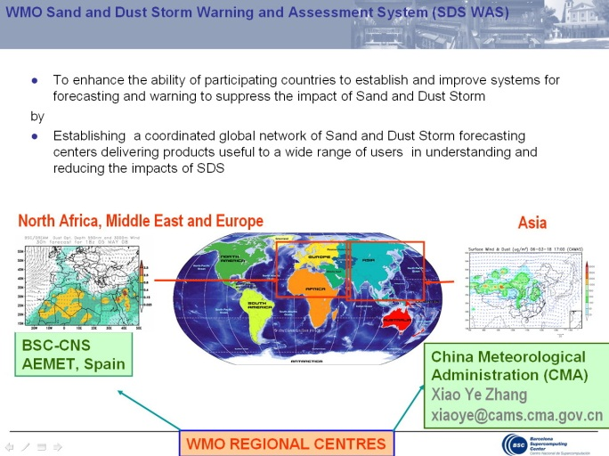
Earth Sciences research lines
Air Quality Forecast
Climate change modelling
Transfer technology
(EIA and AQ studies)
Mineral dust transport:
BSC-DREAM8b
Atmospheric modelling: development of NMMB/BSC-CTM
WMO SDS WAS [AEMET-BSC]

Slide 9
Atmospheric modeling

Slide 10
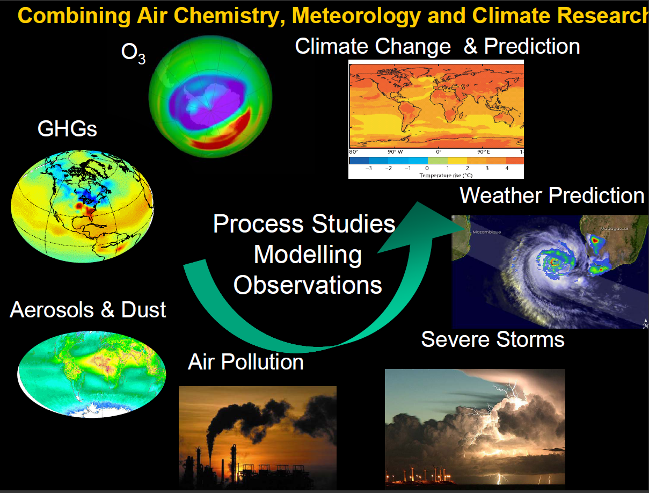

Slide 11
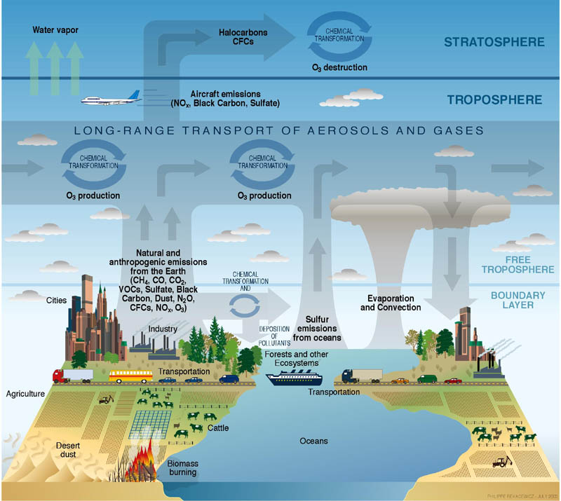
Atmospheric chemistry – air quality

Slide 12
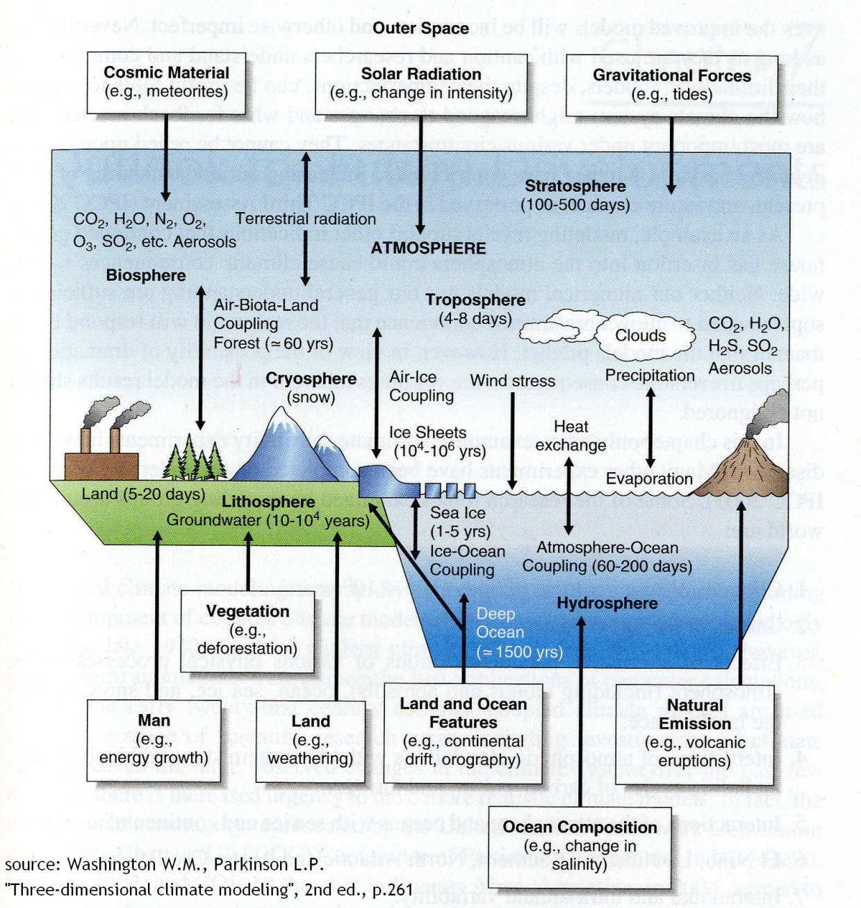
The Climate System
Readapted from: www.metoffice.gov.uk/research/hadleycentre/models/climate_system.html
CLIMATE SYSTEM:
Atmosphere: circulation, the heat transfer to and from the sun, formation of clouds and atmospheric reactive flows that determine the concentrations of its chemicals.
Ocean: interaction of ocean and atmosphere through exchange of momentum, heat and water. The ocean is a heat sink and it is a medium of transport of energy from continent to continent.
Land: vegetation, man and soil play an important role in terms of air dynamics and chemicals transport.
Cryosphere: snow, ice and sea-ice influence on the large-scale circulation.
Biosphere: life on earth and in the water has an important impact on the CO₂ cycle.

Slide 13
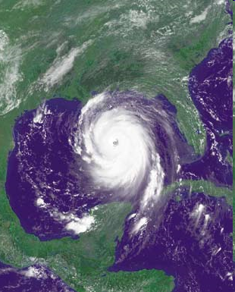
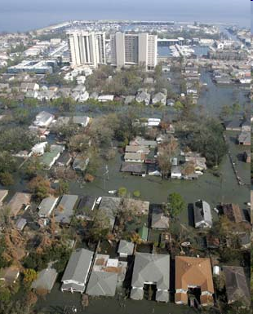
Impacts of atmospheric processes
Extreme weather events include droughts, floods and associated landslides, storms, cyclones and tornadoes, ocean and coastal surges, heat waves and cold snaps.

Slide 14
What is air pollution?
We have to think the atmosphere as a chemical reactor
Main composition:
Emissions of other chemical species to the atmosphere: anthropogenic and natural origin
Chemical reactions in the atmosphere
Accumulation of air masses leading to high concentration of chemical species:
  CO, NOx, SO₂, PM, O₃, VOCs, CO₂, …

Slide 15
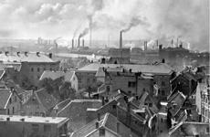
Is it a new problem?
Not a new problem:
  As far back as the 13 th century, people started complaining about coal dust and soot in the air over London, England.
  As industry spread across the globe, so did air pollution.
  The worst air pollution happened in London when dense smog (a mixture of smoke and fog) formed in December of 1952 and lasted until March of 1953. 4,000 people died in one week. 8,000 more died within six months.
A picture is worth a thousand words

Slide 16
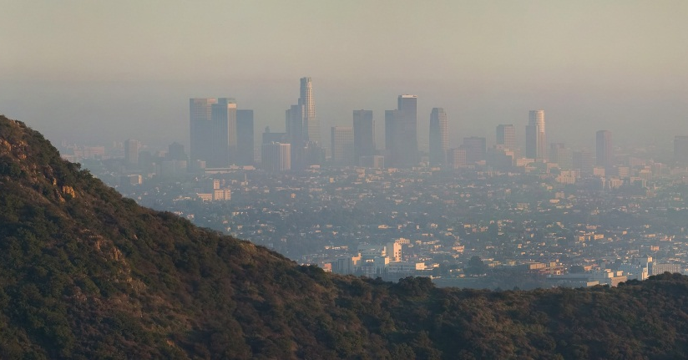
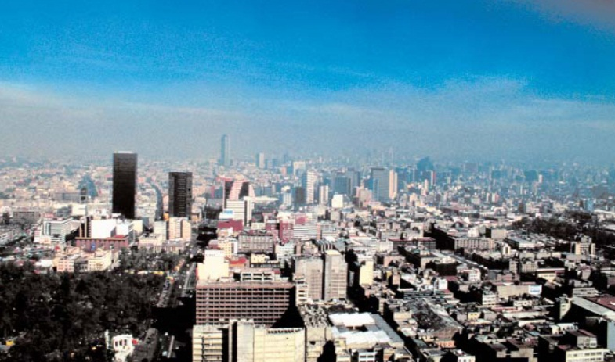
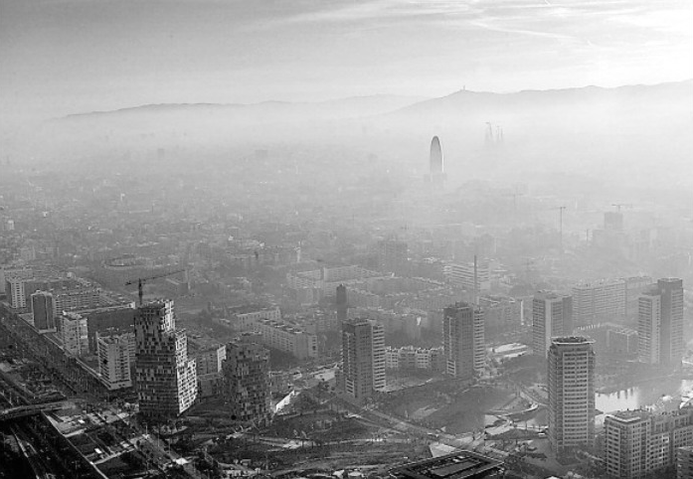
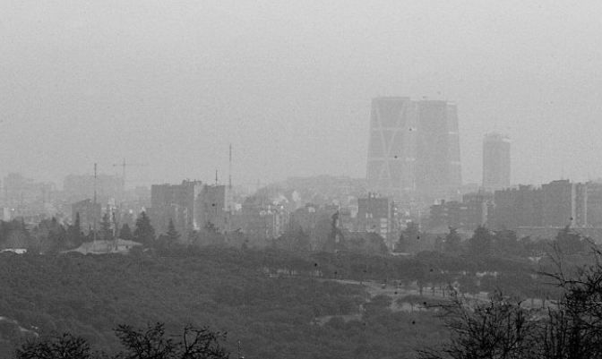
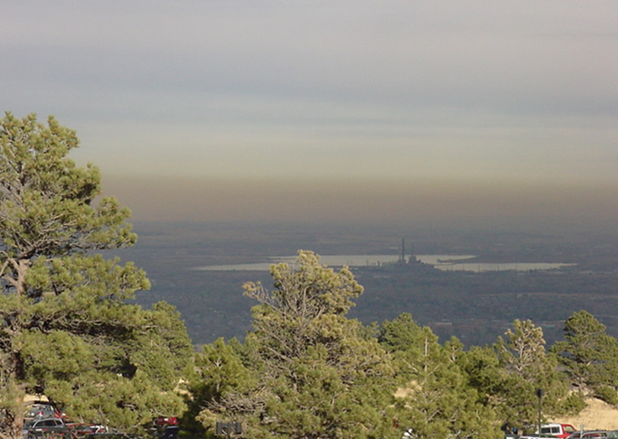
Los Angeles (USA)
México DF (México)
Barcelona (Spain)
Boulder (USA)
Madrid (Spain)

Slide 17
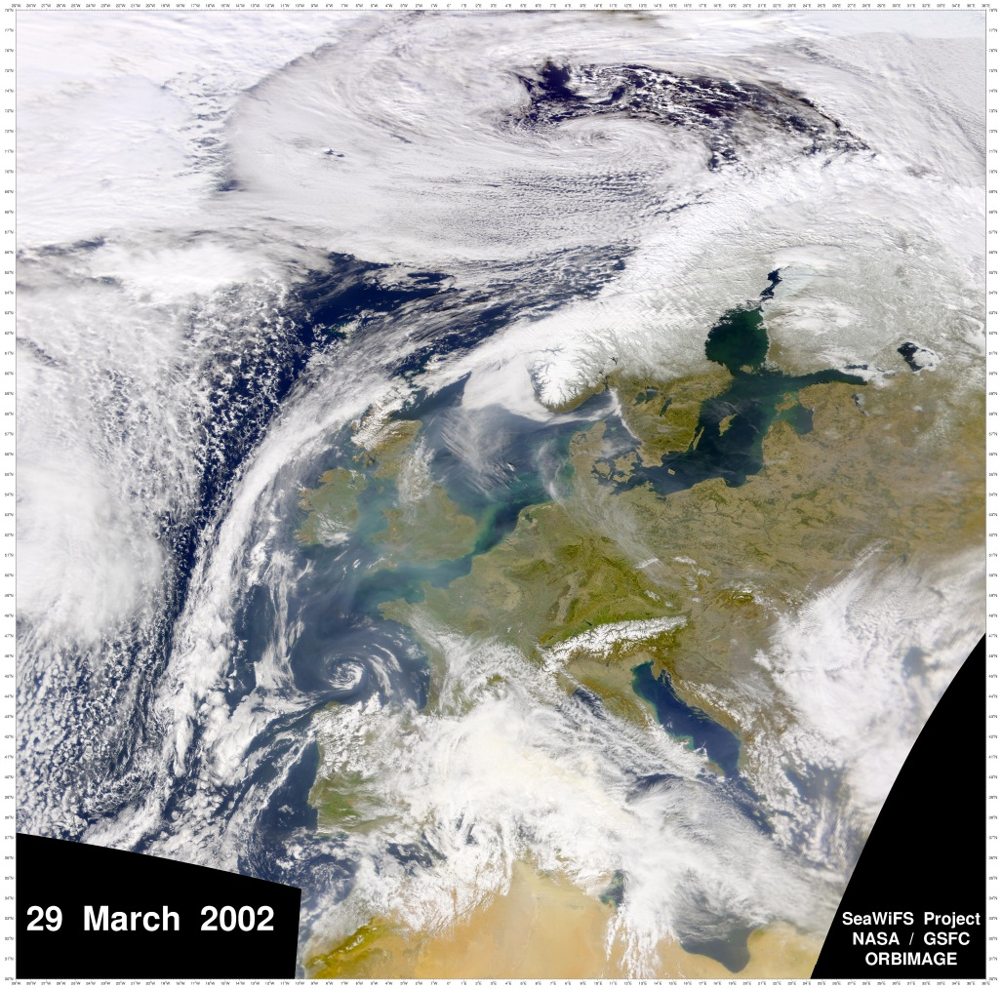
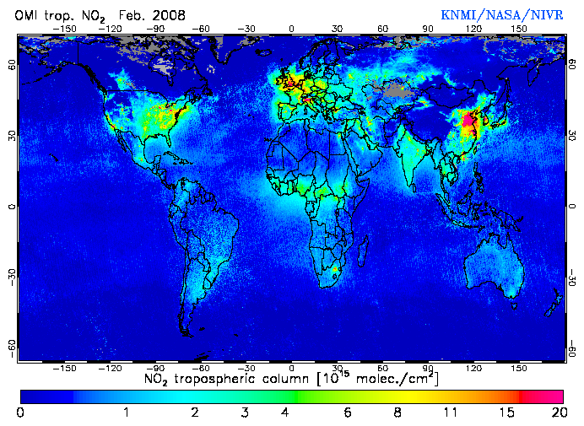
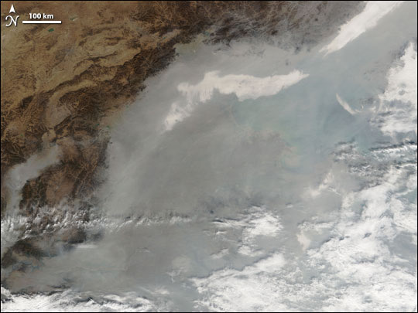
Air Pollution: Europe, South China, the Earth
Effects:
  It can cause illness and even death.
  It damages buildings, crops, and wildlife.
  It has a strong impact in visibility
  Impact on climate system
Not a local problem, wide regions with air pollution problems

Slide 18
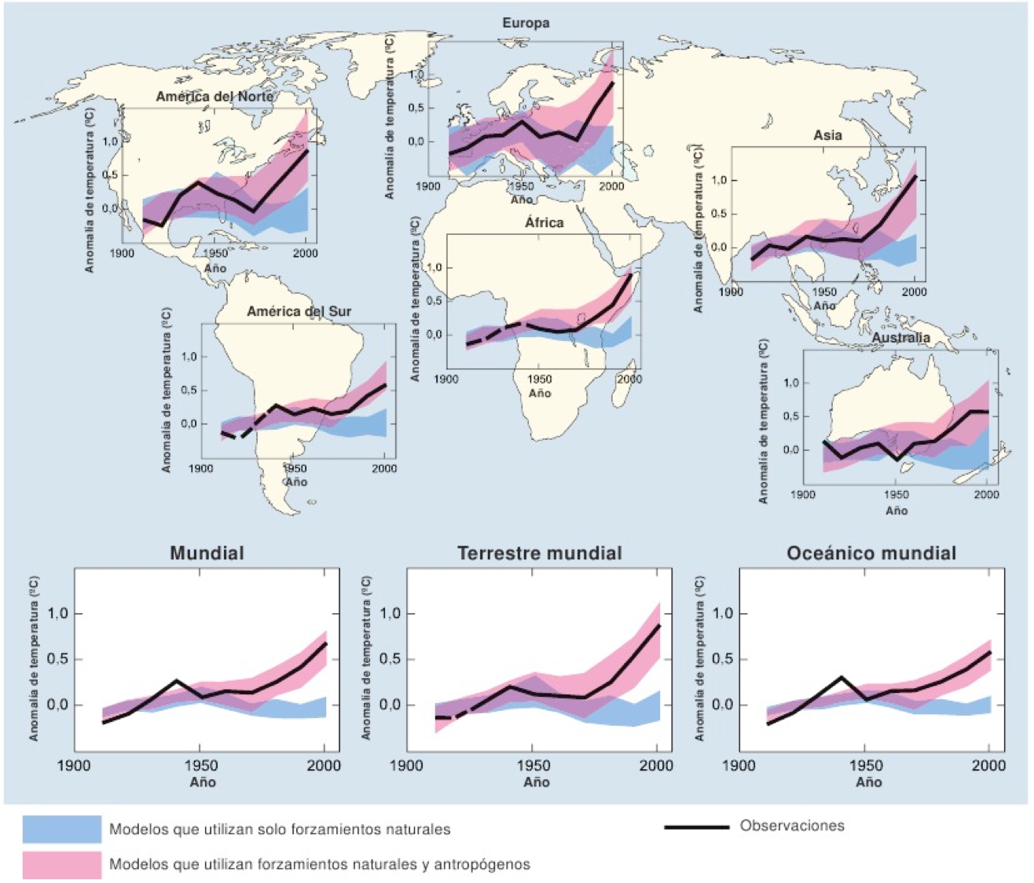
Climate Change described by models

Slide 19
So, what can we do?
Understanding the mechanisms that lead to extreme weather and air pollution episodes
  Measurement campaigns
  Chemical experiments: smog cambers
  Modelling techniques
To provide information and guidance to the authorities
  Information to the population, policy makers
Developing new numerical forecasting systems
  Towards the chemical weather forecast and the Earth System Models

Slide 20
Models: from theory to numerics
Physical model
  Reproduction at smaller scale of a process (e.g., wind tunnels and reproduction of buildings).
Mathematical model
  Set of mathematical equations with physical basis that describes a specific process.
Numerical model
  Computer program where the mathematical model is discretized and codified.

Slide 21

Types of models
Spatial scale
  Street canyon
  Local models
  Mesoscale models
  Synoptic or regional models
  Global models
Temporal scales
  Short-term
  Long-term or climate models
Past or future scenarios
  Hindcast
  Nowcast
  Forecast
  Climate projections
Reference framework:
  Box model
  Gaussian model
  Lagrangian model
  Eulerian model

Slide 22
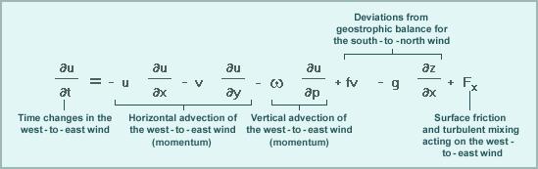
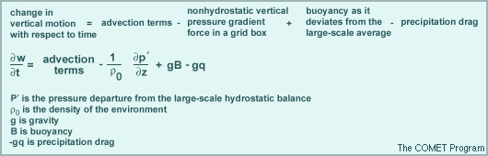
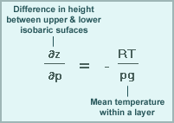

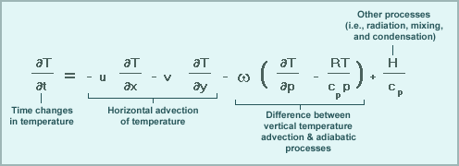
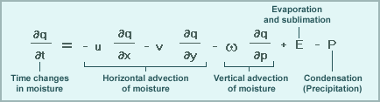
How do we model the evolution of the atmosphere?
Meteorological models – Numerical Weather Prediction
Resolving the full compressible primitive equations:
Momentum conservation
Mass conservation
Energy conservation
Moisture conservation
Partial Differential Equations
No analytic solution available: need of numerical approximations

Slide 23
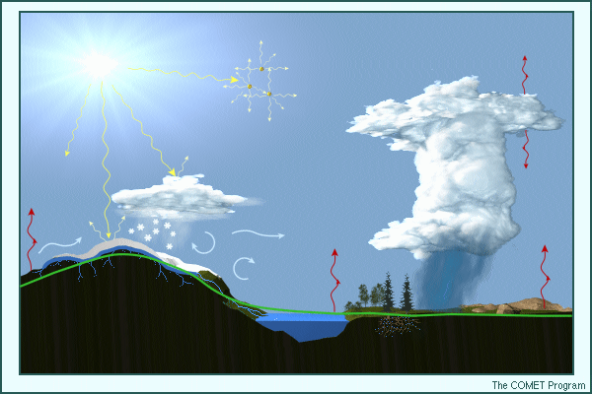
Don’t forget important physical processes: physical parameterizations
Parameterization: account for unresolved grid scale processes.
Incoming solar radiation
Scattering by aerosols
Emission from clouds
Absorption by the atmosphere
Reflection/absorption by coluds
Deep convection
Condensation
Snow
Turbulence
Evaporation
Rain
Soil water/Snow melt
Topography
Vegetation
Sensible heat flux
Surface roughness
Snow/Ice/Water cover
Soil properties

Slide 24
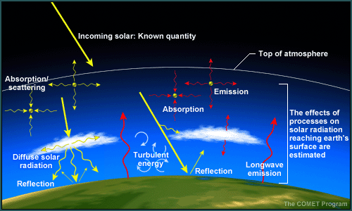
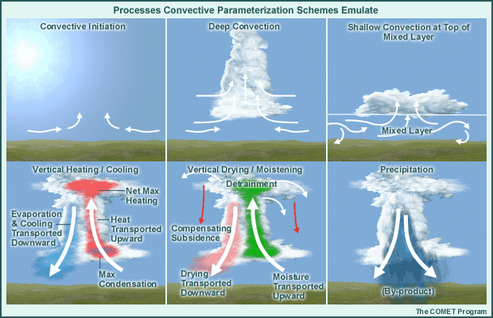
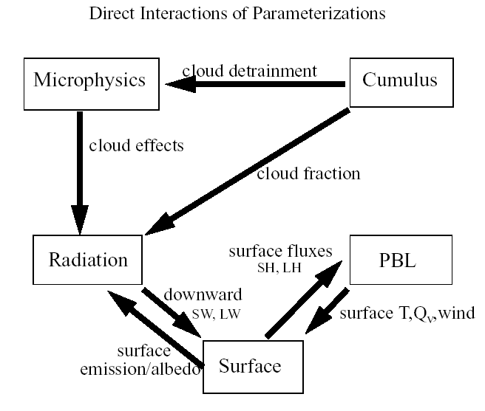
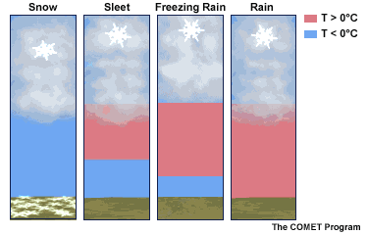
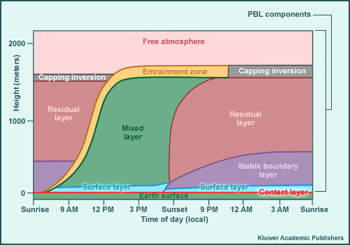
Radiation scheme
Cummulus scheme
Incoming solar radiation
Scattering by aerosols
Emission from clouds
Absorption by the atmosphere
Reflection/absorption by coluds
Deep convection
Condensation
Snow
Turbulence
Evaporation
Rain
Soil water/Snow melt
Topography
Vegetation
Sensible heat flux
Surface roughness
Snow/Ice/Water cover
Soil properties
Microphysics scheme
PBL scheme

Slide 25
Atmospheric chemistry and Air pollution processes
Dispersion
Transport
Chemical/
Physical
transformation
Primary
Aerosols
Gases
Human health
Climate
Visibility
Secondary
Aerosols
Gases
Emission
Wet and dry
deposition
Sources:
Anthropogenic
Biogenic
Geogenic
Aquatic ecosystems
Forests
Agricultural crops
Materials

Slide 26

How do we model air pollution and atmospheric chemistry?
The dispersion equation:
  Advection, diffusion, reaction-chemistry, emissions and deposition
Meteorology
C – concentration of pollutant
Kh – lateral diffusion coefficient
Kz – turbulence exchange coefficient
Emissions
Chemistry

Slide 27



The chemical term
The chemical mechanism
Ordinary differential equations

Slide 28



Where do we solve the primitive equations? Grid discretization
High performance computing resources:
If we plan to solve small scale features we need higher resolution in the mesh and so more HPC resources are required.

Slide 29




Numerical approaches
Computers are not designed to solve differential equations directly
Approximating Calculus with Algebra
  Finite differences
  Finite volumes
  Spectral transforms
  Finite elements

Slide 30



Finite differences: Discretization in space

Slide 31





Finite differences: Discretization in time
Forward Euler
(explicit)
Backward Euler
(implicit)
Many discretization options with different stability, accuracy and cost

Slide 32











Atmospheric sciences tightly coupled with HPC expansion
1979: Cray 1-A
1 cpu (80 MHz)
Peak 160Mf
1986: Cray XMP-48
4 cpu (112 MHz)
Peak 880Mf
1990: Cray Y-MP 8/8-64
8 cpu (166 MHz)
1992: Cray C90
16 cpu
Peak 16 Gf
1994: Cray T3D
128 cpu
1996: Fujitsu VPP700
116 cpu
Peak 255 Gf
1999: Fujitsu VPP5000
100 cpu (80 MHz)
Peak 960Gf
2002: 2 IBM Cluster 1600
30 p690 SMP
Upgrade: 70 p690+
2006: 2 IBM Cluster
310 p5-575
Peak 38 Tf
2009: 2 IBM Cluster
POWER6 p6-575
Peak 325 Tf
2012: 2 IBM Cluster
POWER7
Peak 1,47 Pf
ECMWF Supercomputer history

Slide 33

Inclusion of more coupled processes
IPCC(2001)

Slide 34




Historical evolution of NWP and AQM → future
(IS-ENES, 2011)

Slide 35


Unified models: meteorology – chemistry – climate
Embedding chemistry processes within a meteorological core driver
Notes:
Here we see a nice picture of the structure of the system.
Where we have the dynamics of the meteorological model on one side coupled with the physics of the diabatic processes of the primitive equations. The advection and horizontal diffusion of tracers, in our case aerosols and gases, are done with the numerics of the meteorology, and the different emission, transormation or reaction and deposition are solved in the physics part of the model.
The different processes considered are depicted in the bottom figure. We consider online emission of dust, sea salt, and biogenic gases, advection and difusion, convective mixing, gas-phase chemistry, wet removal, sedimentation dry depostion and direct radiative feedbacks.

Slide 36


Water vapor meteorological simulation

Slide 37

Global aerosol simulation
Source: NASA GSFC

Slide 38
Climate change simulations – EC-Earth

Slide 39






Mineral dust results
Global and regional annual simulations evaluated with:
  Aeronet sun-photometer networks
  LIDAR vertical profiles
  Several satellite products
  Surface concentrations
  Emission and deposition fluxes
a
b
LDA SeaWiFS product
d
c
e
f

Slide 40


Aerosol optical depth on an annual cycle
Notes:
Here we can see the results of an annual simulation of dust with the model configured at global scale and a focus over the north Africa region. The sesonal mean model results are plotted in the left column, the results of MISR satellite in the central colum and the OMI aerosol index in the right column.
We can see how the model is able to capture and reproduce the spatial distribution of the emissions over the north African domain for the different seasons of the year.
This results have been compared also against aeronet stations

Slide 41

Sea-salt results

Slide 42




Gas phase results

Slide 43
Thank you!
For further information please contact
oriol.jorba@bsc.es
kim.serradell@bsc.es

