Slide 1

Atmospheric modeling:
A technical and practical approach
Kim Serradell
kim.serradell@bsc.es
Barcelona Supercomputing Center-Centro Nacional de Supercomputación
Earth Sciences Department. Barcelona.
Aules d’Empresa 2013 – Facultat d’Informática de Barcelona – January 25th 2013

Slide 2
Outline
Presentation
Introduction
Models in BSC
Parallelizing Atmospheric Models
Two practical cases:
  NMMB: Nonhydrostatic Multiscale Model on the B grid
  WRF: Weather Research Forecast

Slide 3
Presentation
Made my education in FIB.
Finished on 2005.
Then working in different places.
And four years ago, I went to the BSC and started to work on Earth Sciences Dpt.

Slide 4
IT tasks in Earth Sciences
Assuring daily execution on the model
  Crash recovery
  Monitoring the Model
  Assuring transfers
Timing the execution
  Results have to be on time
Data Storage
  Huge size of data
  Storing and cleaning
Helping researchers in modeling/running/optimization
And many more...

Slide 5
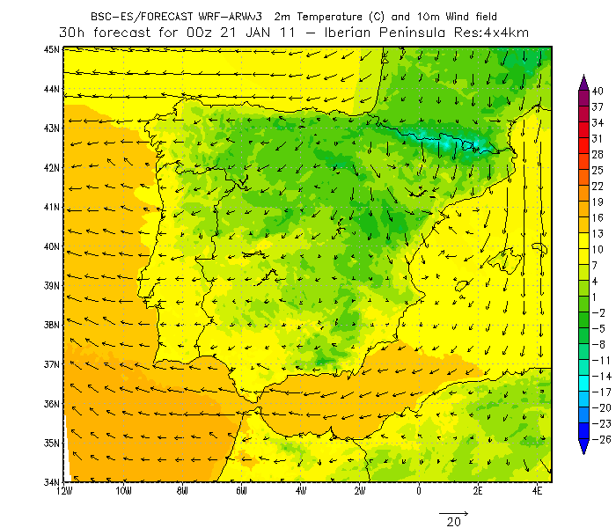
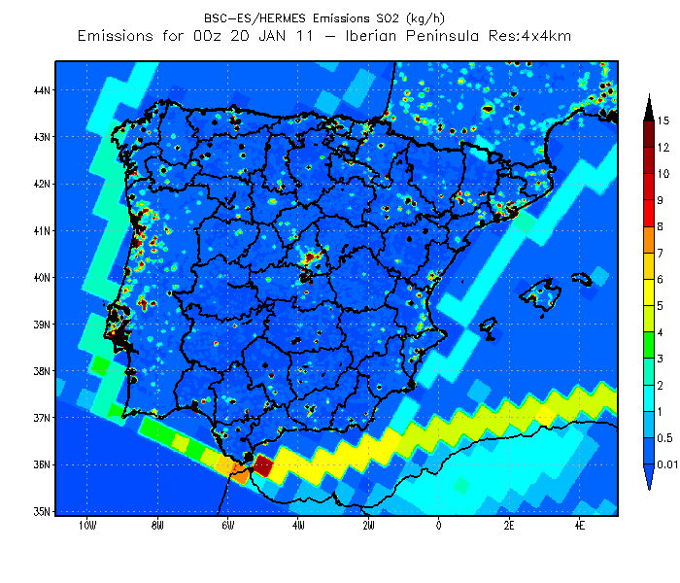
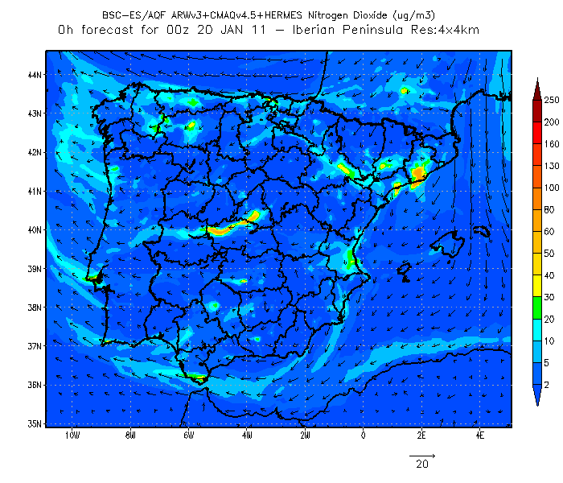
Models in ES-BSC
Meteorological Modeling
  WRF: Weather Research Forecasting
    Fortran Code
    MPI, OpenMP and CUDA
Emissions
  HERMES: High-Elective Resolution Modelling
  Emissions System V2
    C++ Code
    MPI
Air Quality Forecasting
  CMAQ: Community Multiscale Air Quality
    Fortran Code
    MPI

Slide 6
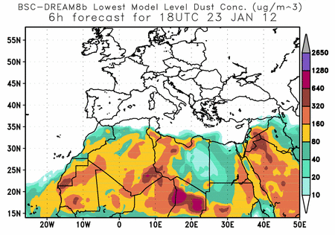
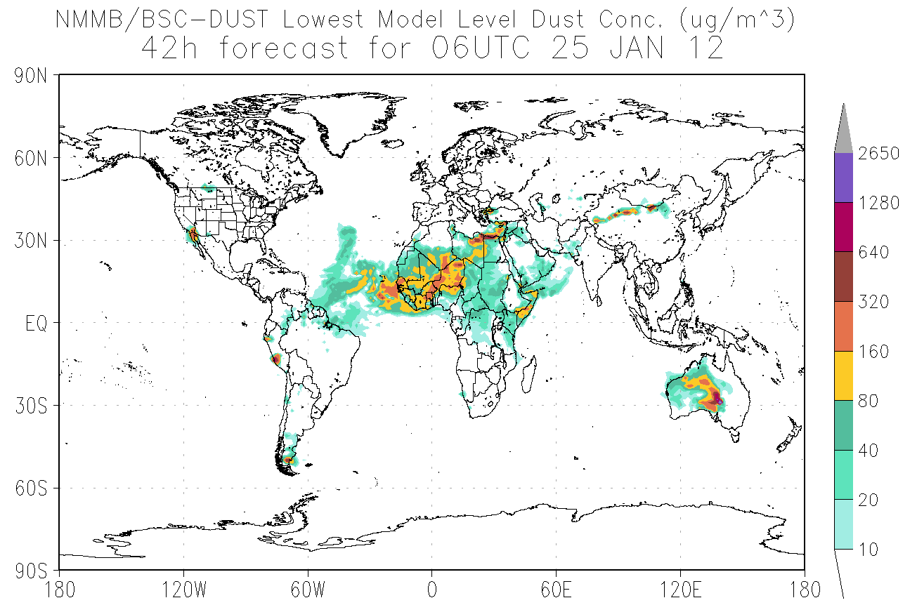
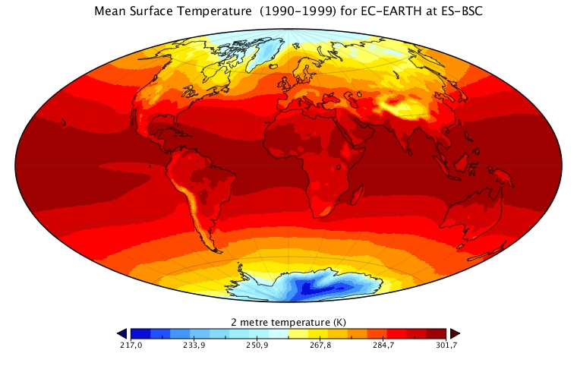
Models in ES-BSC
Mineral Dust Modeling
  BSC-DREAM8b: Dust REgional Atmospheric
  Model
  Fortran Code
  Not parallel
NMMB/BSC-CTM
  Meteorology-Chemistry coupled model
  Meteo. Driver: Nonhydrostatic Multiscale
  Model on the B grid (NMMB)
  Fortran Code
  MPI
Climate Change
  EC-EARTH
  Fortran, C
  MPI, OpenMP

Slide 7
What does “Simulate” means from an IT point of view ?
INITIAL
DATA
MODEL
RESULTS
Observations
Data from other models
Empty
A collection of codes
Binary data
Maps
Plots
Text files

Slide 8
Types of Simulations
Climate Simulations
  Global scale
  Large periods
  Huge amount of data created
  Execution time is not a critical constraint
  Example: EC-EARTH model for 1900 to 2100, year simulation
Operational Simulations
  Global/Regional Scale
  Small periods
  Data created is smaller but postprocess products are more important
  Execution time and reliabilty are very critical
  Example: Daily weather forecast

Slide 9
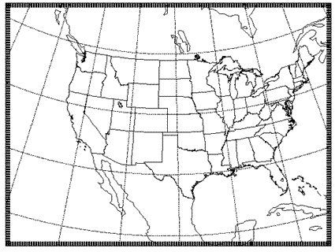
Parallelizing Atmospheric Models
We need to be able to run this models in Multi-core architectures.
What’s the way to do it ¿?
  Model domain is decomposed in patches
  Patch: portion of the model domain allocated to a distributed/shared memory node.
Patch
MPI/OpenMP Communication
with neighbours

Slide 10
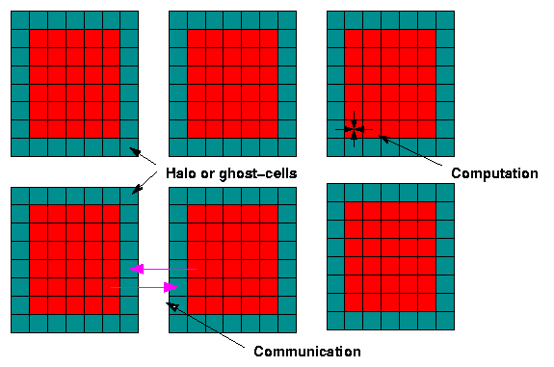
Parallelizing Atmospheric Models

Slide 11
Computational Demands
Which domains are we simulating ¿?
  Barcelona
  Catalunya
  Spain
  World
Which resolution ¿?
  1 km² 4 km² 12 km² 50 km²
How many variables we want to compute ¿?
  T2
  U10, V10
  QRAIN, QVAPOR
Increasing this parameters, increases the system constraints
  Computation Needs (CPU’s, Memory Bandwith…)
  Data Storage
Define this parameters in function of your hardware and time to serve forecast.

Slide 12
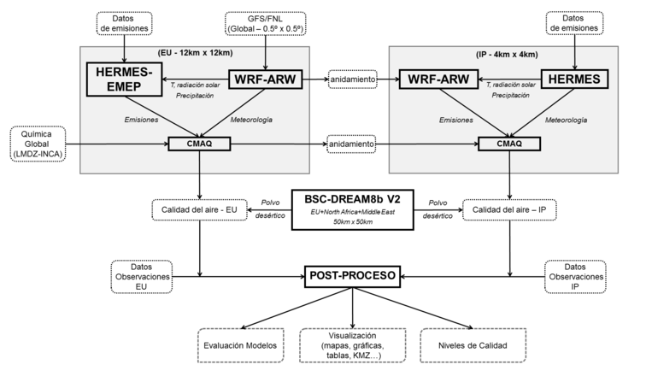
Workflow

Slide 13
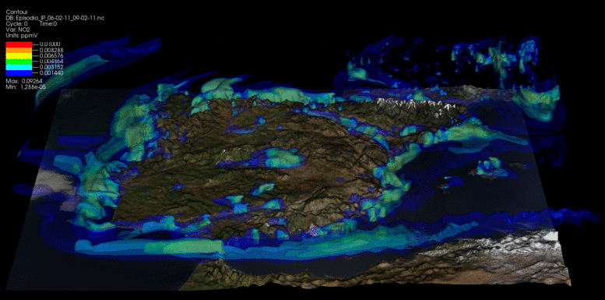
3D Outputs

Slide 14
Practical Examples
NMMB Case:
Optimizing an atmospheric model.
WRF Case:
Setting and running an atmospheric model.

Slide 15
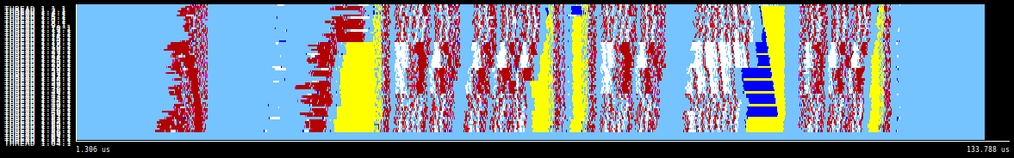
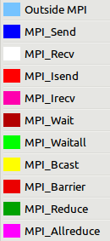
NMMB: Nonhydrostatic Multiscale Model on the B grid
We run this model and we try to optimize it.
Many different approaches to do it.
We are interested on communications pattern. We will use a tracing software to represent what is doing the model.
Paraver Tool: http://www.bsc.es/computer-sciences/performance-tools/paraver
Traces lowres config, 64 CPU’s, one timestep.

Slide 16
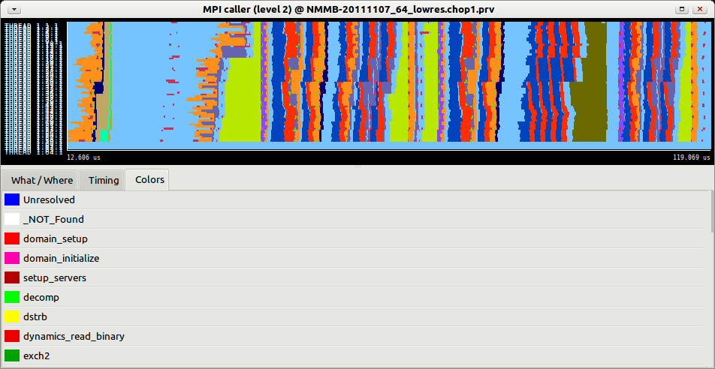
NMMB
With this software, we can answer questions as:
  How/When are the routines executed ¿?

Slide 17
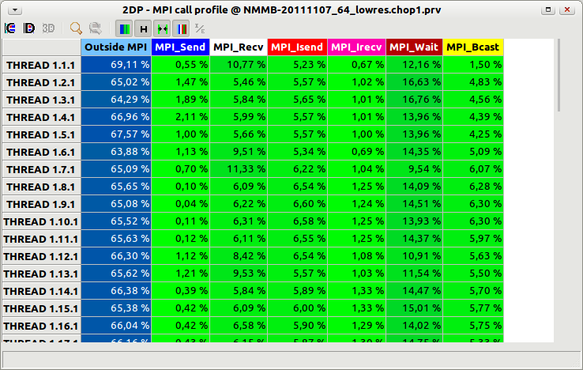
NMMB
  Is taking more time in calculate or communicate ¿?

Slide 18
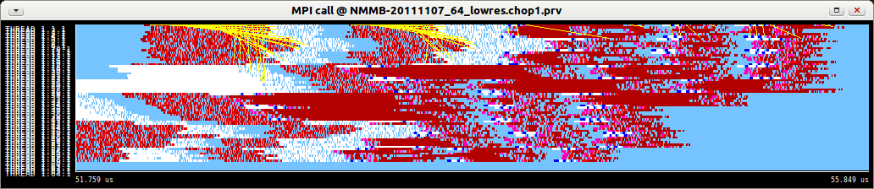
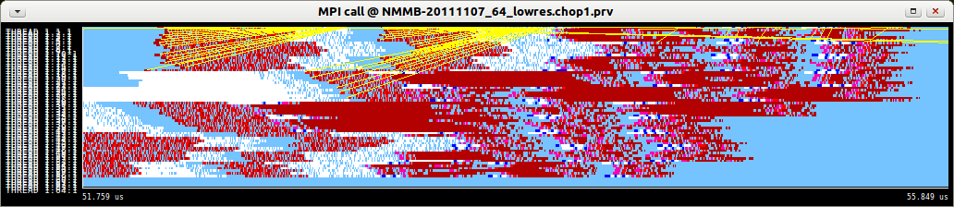
NMMB
  CPU#1 is sending to ¿?
  CPU#1 is receiving from ¿?

Slide 19
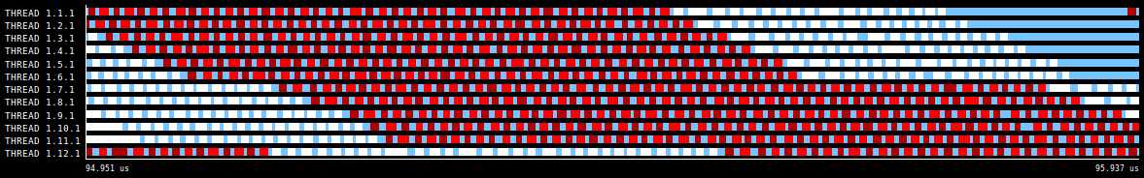
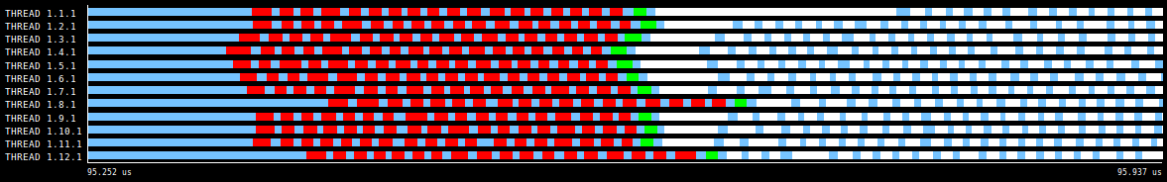
NMMB: Optimizations
N WAITS, 1 WAITALL
ISEND / RUN / WAIT, ISEND / RUN / WAIT, ISEND / RUN / WAIT…
“Staircase effect”, less performance
(ISEND / RUN, ISEND / RUN, ISEND / RUN…) WAITALL…
“Staircase effect” dissapears, much balanced.

Slide 20
WRF: Introduction
Weather Research Forecast is the latest numerical program model to be adopted by NOAA's National Weather Service. It is also being adopted by meteorological services worldwide.
WRF to be in the public domain for use by any person.
Current version: 3.4.1
Software requirements
  Fortran 90 or 95 and C compiler
  perl 5.04 or later
  If MPI and OpenMP compilation is desired, MPI or OpenMP libraries are required
  WRF I/O API supports netCDF, pnetCDF, PHD5, GriB 1 and GriB 2
  csh and Bourne shell, make, M4, sed, awk, and the uname command
Nice Online tutorial: http://www.mmm.ucar.edu/wrf/OnLineTutorial/index.htm

Slide 21
WRF: Architectures
If you have a computer at home, you can run WRF and make your own forecast !!!
WRF can run on a large number of architectures.
For example, the choices for a Linux computer looks like this:
dmpar: distributed memory parallelism (MPI)
smpar: shared memory parallelism (OpenMP)
1. Linux i486 i586 i686, gfortran compiler with gcc (serial)
2. Linux i486 i586 i686, gfortran compiler with gcc (smpar)
3. Linux i486 i586 i686, gfortran compiler with gcc (dmpar)
4. Linux i486 i586 i686, gfortran compiler with gcc (dm+sm)
5. Linux i486 i586 i686, g95 compiler with gcc (serial)
6. Linux i486 i586 i686, g95 compiler with gcc (dmpar)
7. Linux i486 i586 i686, PGI compiler with gcc (serial)
8. Linux i486 i586 i686, PGI compiler with gcc (smpar)
9. Linux i486 i586 i686, PGI compiler with gcc (dmpar)
10. Linux i486 i586 i686, PGI compiler with gcc (dm+sm)
11. Linux x86_64 i486 i586 i686, ifort compiler with icc (non-SGI installations) (serial)
12. Linux x86_64 i486 i586 i686, ifort compiler with icc (non-SGI installations) (smpar)
13. Linux x86_64 i486 i586 i686, ifort compiler with icc (non-SGI installations) (dmpar)
14. Linux x86_64 i486 i586 i686, ifort compiler with icc (non-SGI installations) (dm+sm)
15. Linux i486 i586 i686 x86_64, PathScale compiler with pathcc (serial)
16. Linux i486 i586 i686 x86_64, PathScale compiler with pathcc (dmpar)

Slide 22
WRF: Compilation
To run it in a platform, you need to compile it with the right compiler, options and flags.
# Settings for x86_64 Linux, gfortran compiler with gcc (smpar)
#
DMPARALLEL = 1
OMPCPP = -D_OPENMP
OMP = -fopenmp
OMPCC = -fopenmp
SFC = gfortran
SCC = gcc
CCOMP = gcc
DM_FC = mpif90 -f90=$(SFC)
DM_CC = mpicc -cc=$(SCC)
FC = $(SFC)
CC = $(SCC) -DFSEEKO64_OK
LD = $(FC)
RWORDSIZE = $(NATIVE_RWORDSIZE)
PROMOTION = # -fdefault-real-8 # uncomment manually
ARCH_LOCAL = -DNONSTANDARD_SYSTEM_SUBR
CFLAGS_LOCAL = -w -O3 -c -DLANDREAD_STUB
LDFLAGS_LOCAL =
CPLUSPLUSLIB =
ESMF_LDFLAG = $(CPLUSPLUSLIB)
FCOPTIM = -O3 -ftree-vectorize -ftree-loop-linear -funroll-loops
FCREDUCEDOPT = $(FCOPTIM)
FCNOOPT = -O0
FCDEBUG = # -g $(FCNOOPT)
FORMAT_FIXED = -ffixed-form
FORMAT_FREE = -ffree-form -ffree-line-length-none
FCSUFFIX =
BYTESWAPIO = -fconvert=big-endian -frecord-marker=4
FCBASEOPTS_NO_G = -w $(FORMAT_FREE) $(BYTESWAPIO)
FCBASEOPTS = $(FCBASEOPTS_NO_G) $(FCDEBUG)
MODULE_SRCH_FLAG =
TRADFLAG = -traditional
CPP = /lib/cpp -C -P
AR = ar
ARFLAGS = ru
M4 = m4 -G
RANLIB = ranlib
CC_TOOLS = $(SCC)
COMPILERS
OPTIMIZATIONS
OPTIONS
Then, you can compile it.

Slide 23
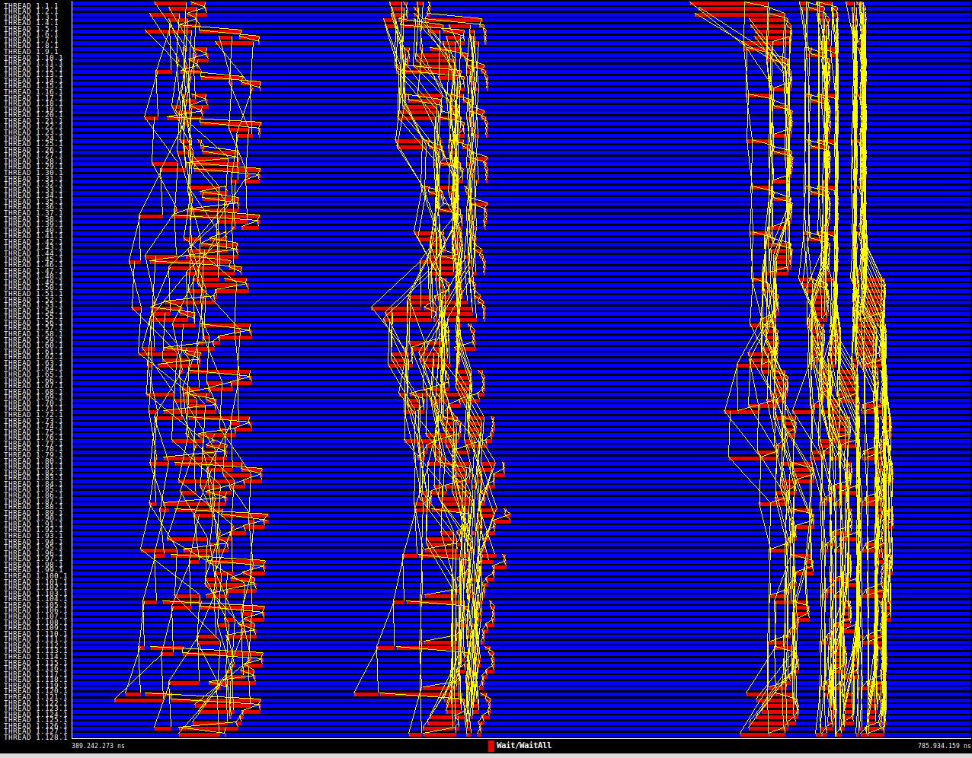
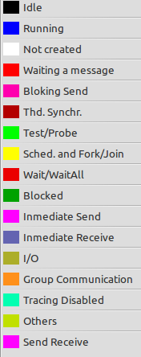
WRF: Running the model
128 CPU’s
Iberian Peninsula
Mare Nostrum

Slide 24
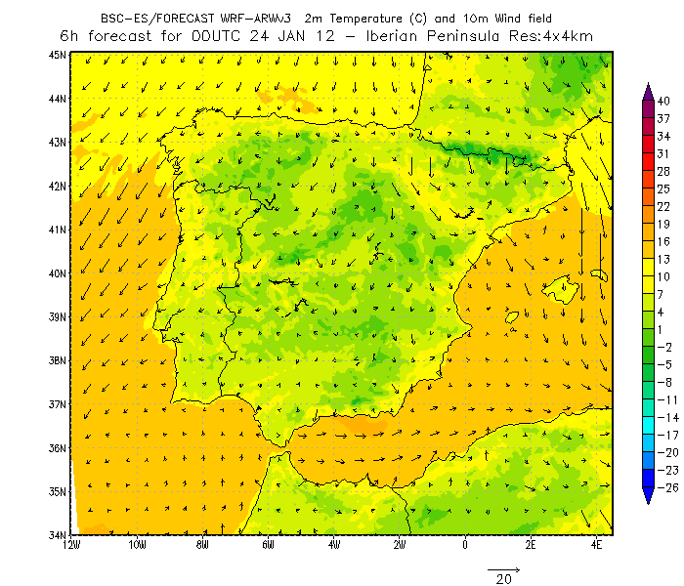
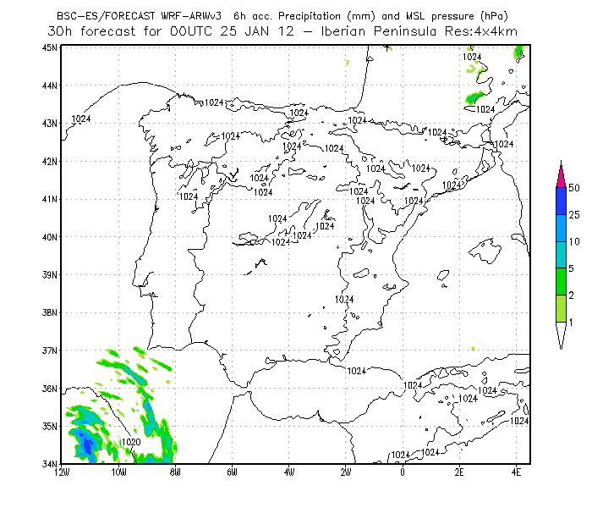
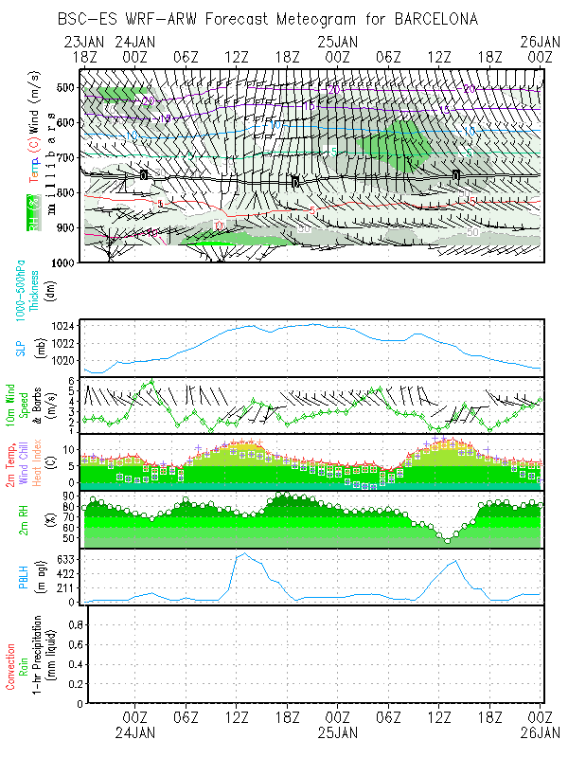
WRF: Viewing Results

Slide 25
GRÀCIES !

